Slide 1
Welcome to our phonics information sharing session 21.09.23

Slide 2
A love of reading is the biggest indicator of future academic success.
OECD (The Organisation for Economic Co-operation and Development)

Slide 3
Phonics and Early Reading
Part 1 – information about how we teach phonics
Part 2 – information about how we teach reading
Part 3 – supporting at home

Slide 4
What is Phonics?
Phonics is a way of teaching children how to read and write.
At Clee Hill we teach synthetic phonics which is a method of teaching where words are broken up into the smallest units of sound.
It helps children hear, identify and use different sounds that distinguish one word from another in the English language

Slide 5
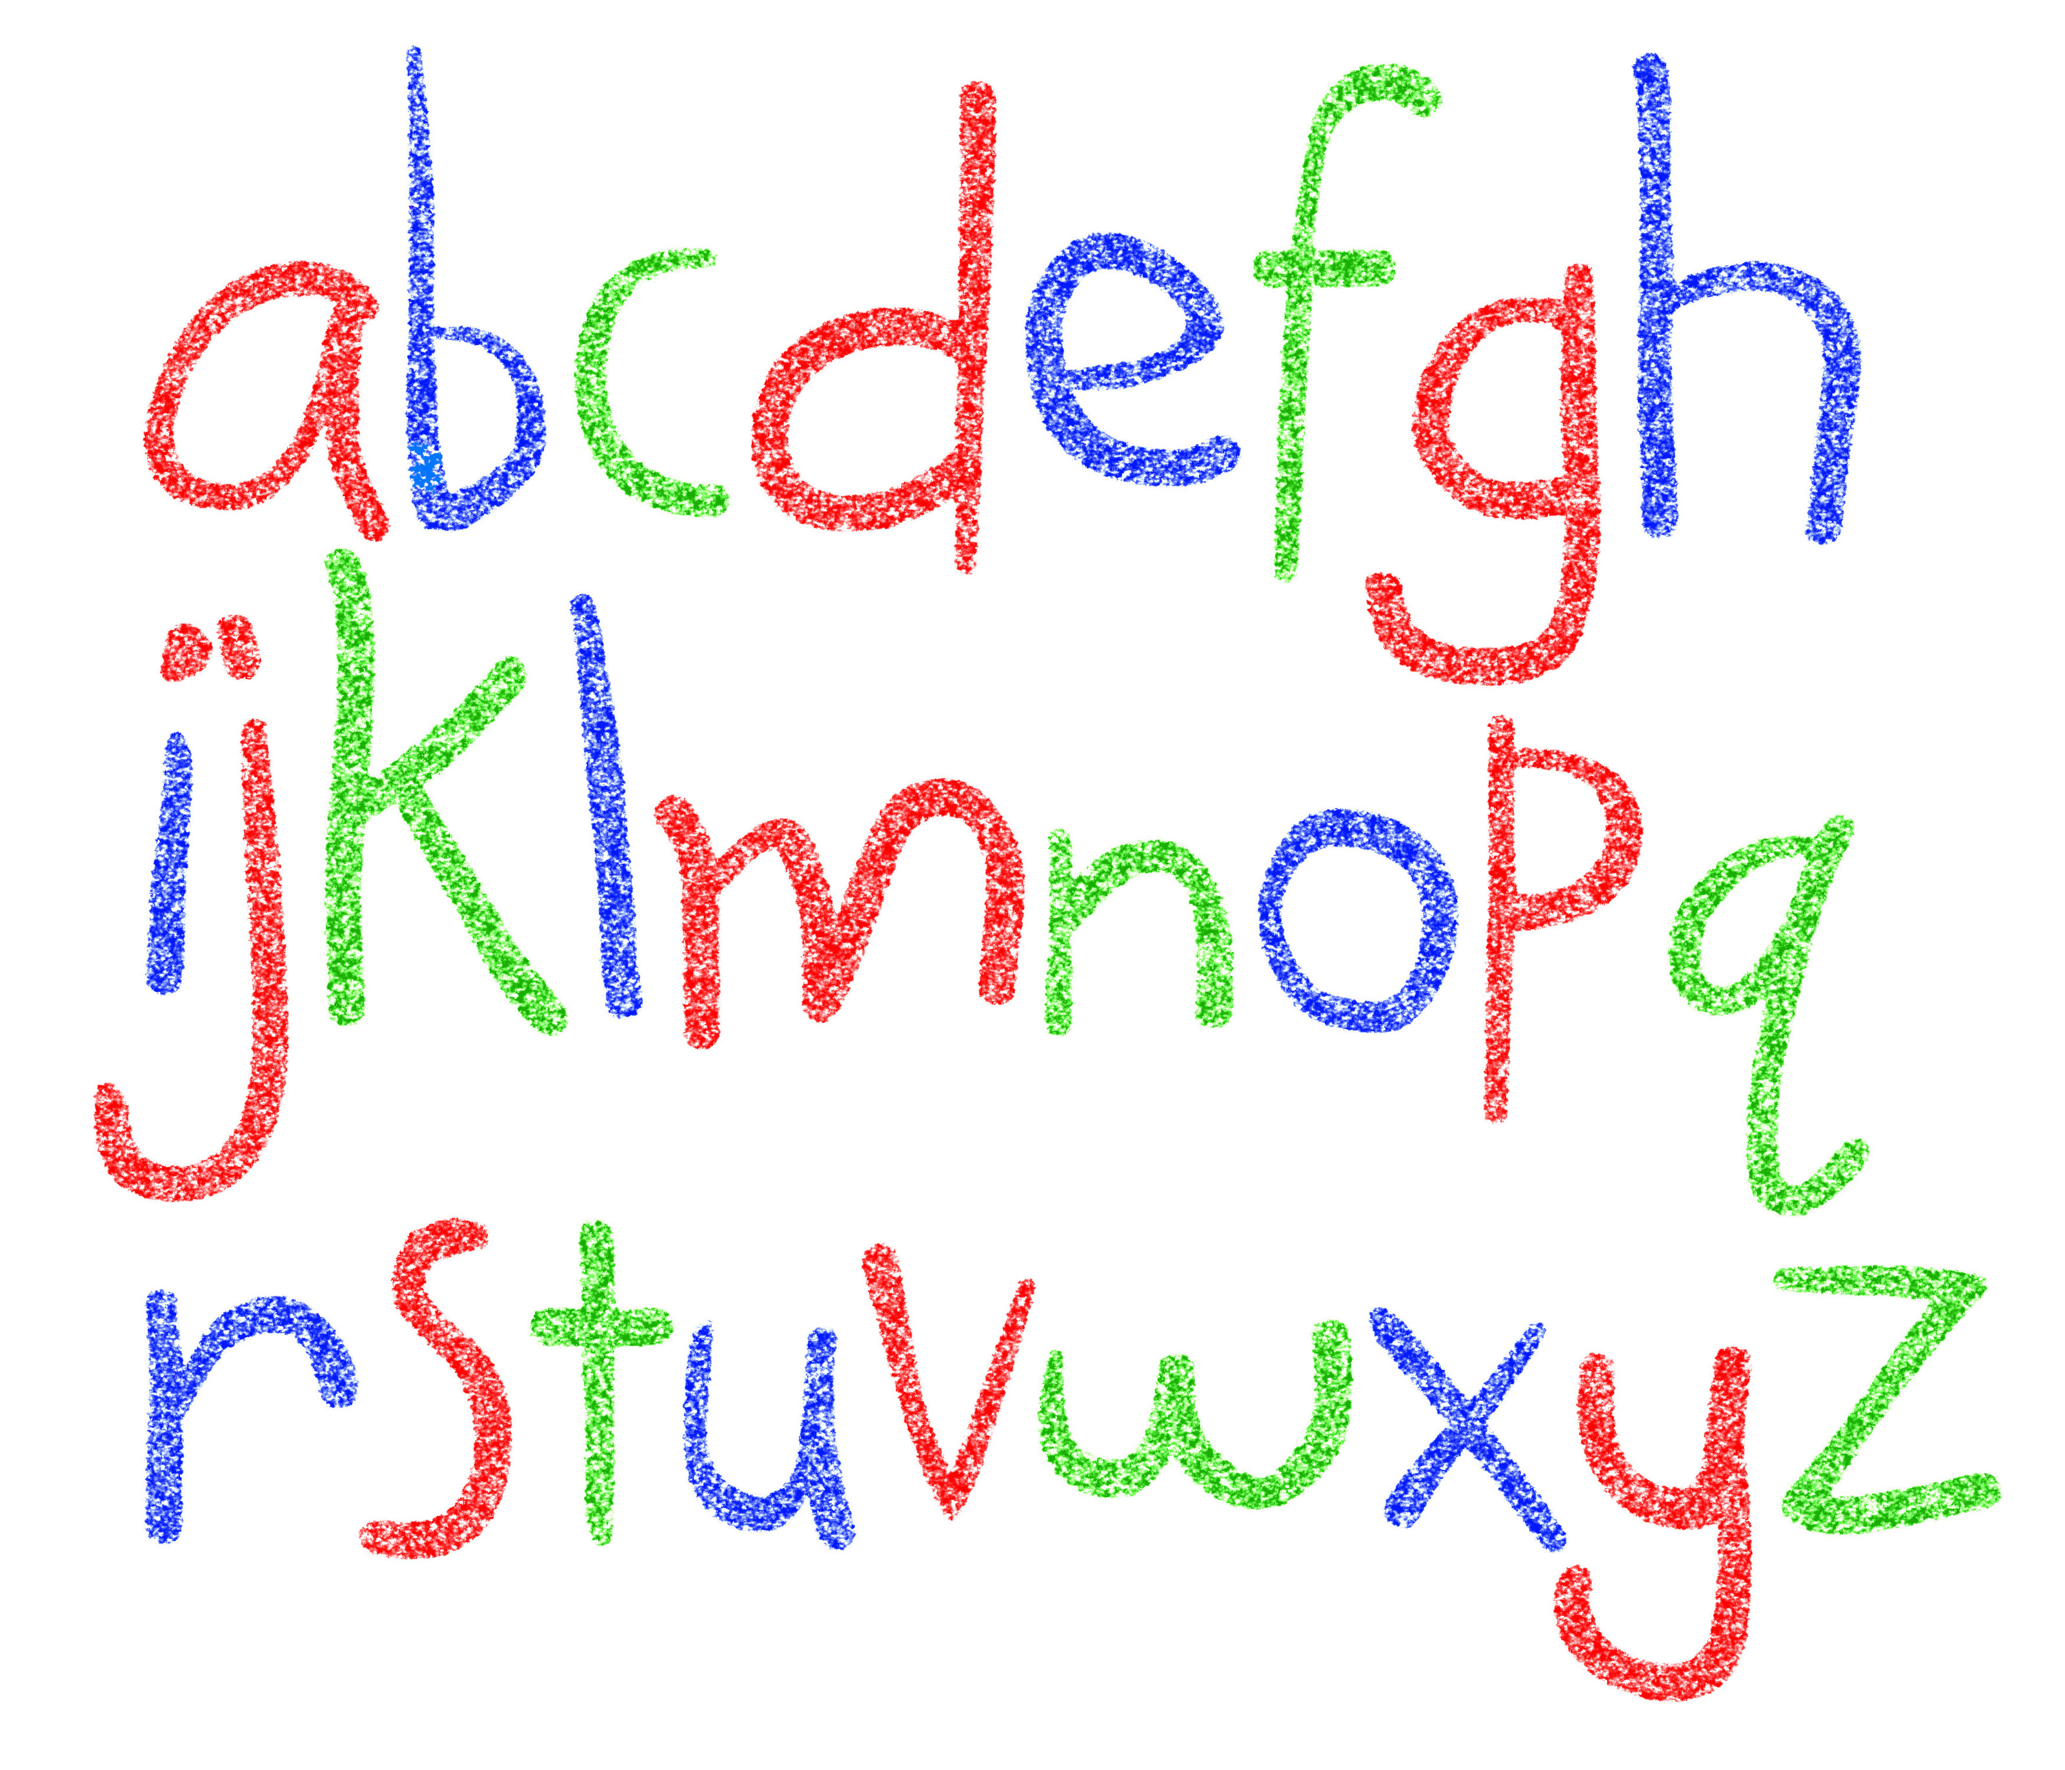
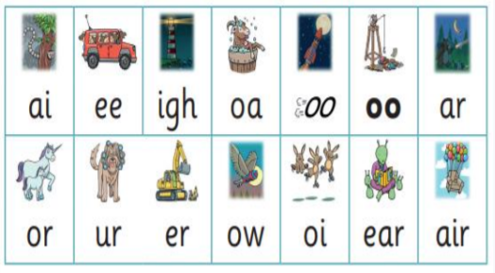
Did you know?
The English language has:-
26 letters
44 sounds
Over 100 different ways to spell
those sounds

Slide 6
New DFE Guidance for Early Reading and Phonics
The journey to independent reading and writing begins with Phonics
littlewandlelettersandsounds.org.uk
Why Little Wandle?
Excellent training for all staff to ensure consistency.
Every aspect of phonics and reading included in a detailed, thorough and systematic approach.
Engaging resources without distracting from the learning.
Comprehensive system for identifying and supporting children requiring extra help
Useful support for parents.
Notes:
Government changes mean a change (for the better) in how we teach phonics and reading at school - make sure there is consistency throughout
Early reading is the stage where children are learning to become fluent readers through the use of phonics

Slide 7
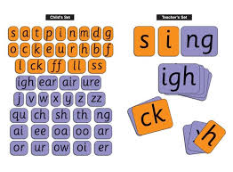
How we teach phonics
Daily short sessions
Currently, children in reception and year 1
have one phonics session per day.
Specific order of teaching
m-u-s-t
Synthetic phonics
Correct pronunciation is vital - Videos on our website
http://chcacademy.co.uk/reading-and-phonics/early-reading-and-phonics
Revisit previously
taught sounds at
start of each lesson
Practice makes
permanent
Repeated practice

Slide 8
Notes:
Phonemes taught in order start to read words asap
LW has a picture pneumonic to help children remember the phoneme/grapheme

Slide 9
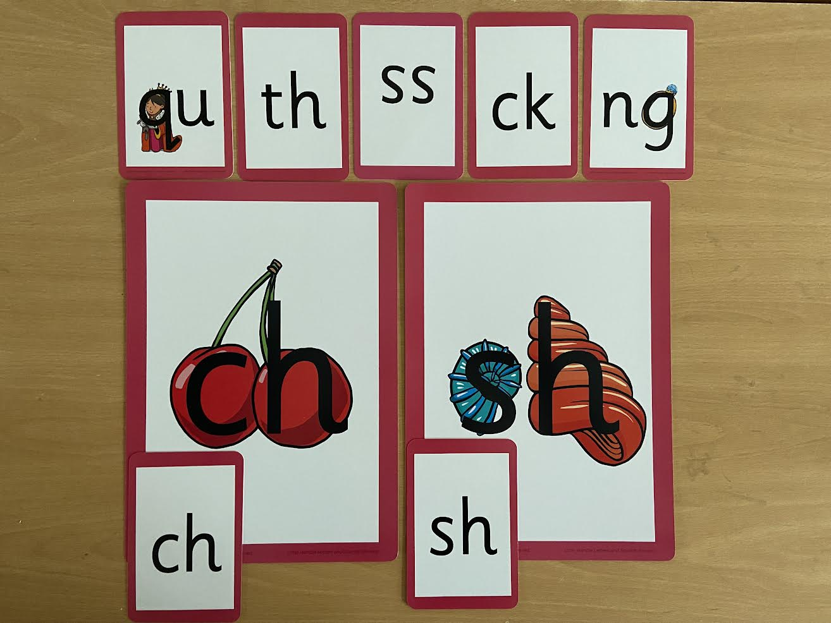
Notes:
Early digraphs mostly consonant digraphs – 2 letters 1 sound

Slide 10
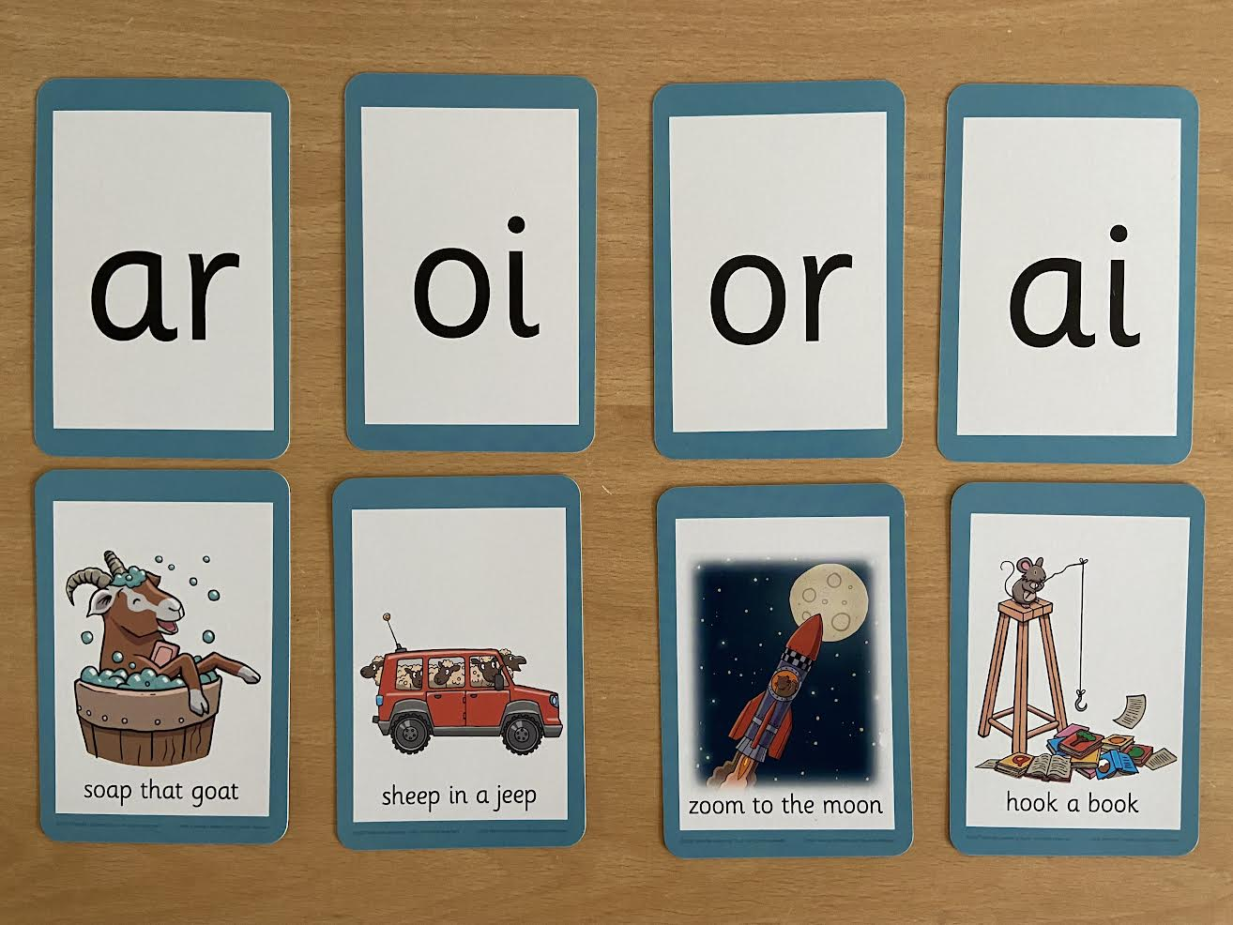
Notes:
Vowel digraphs taught with a short caption to help children remember
Also trigraphs igh, air

Slide 11
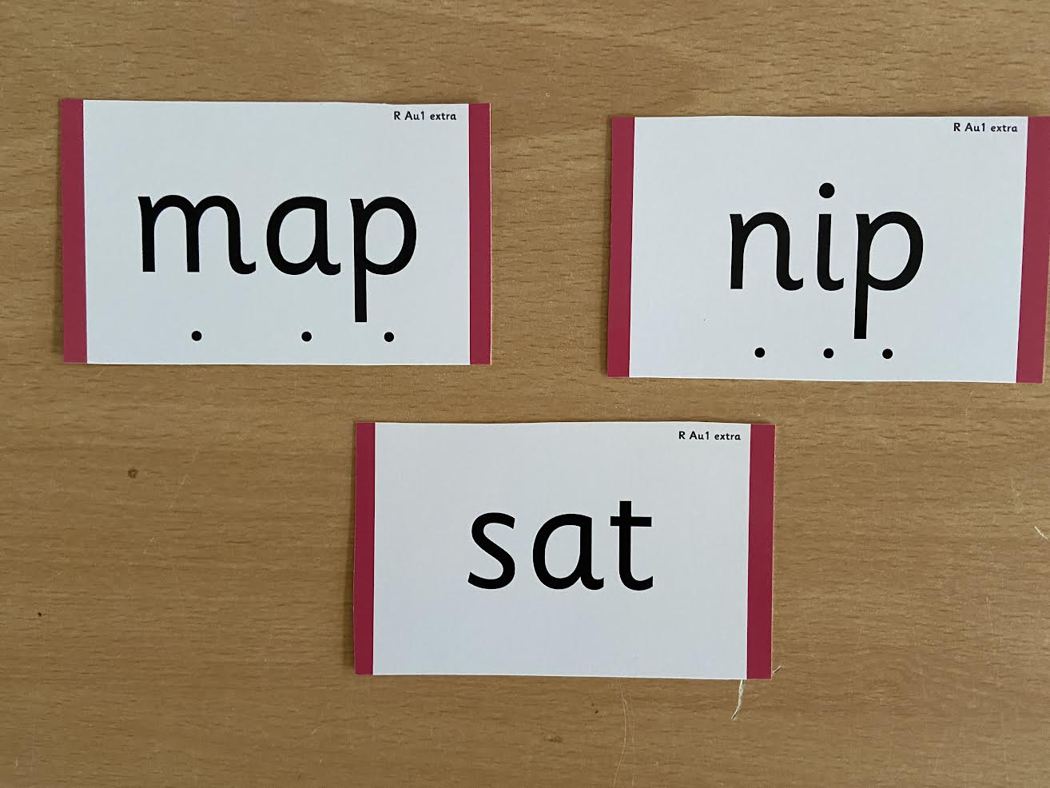
Notes:
During phonics lessons we use Sound buttons so we can sound talk and blend to read

Slide 12
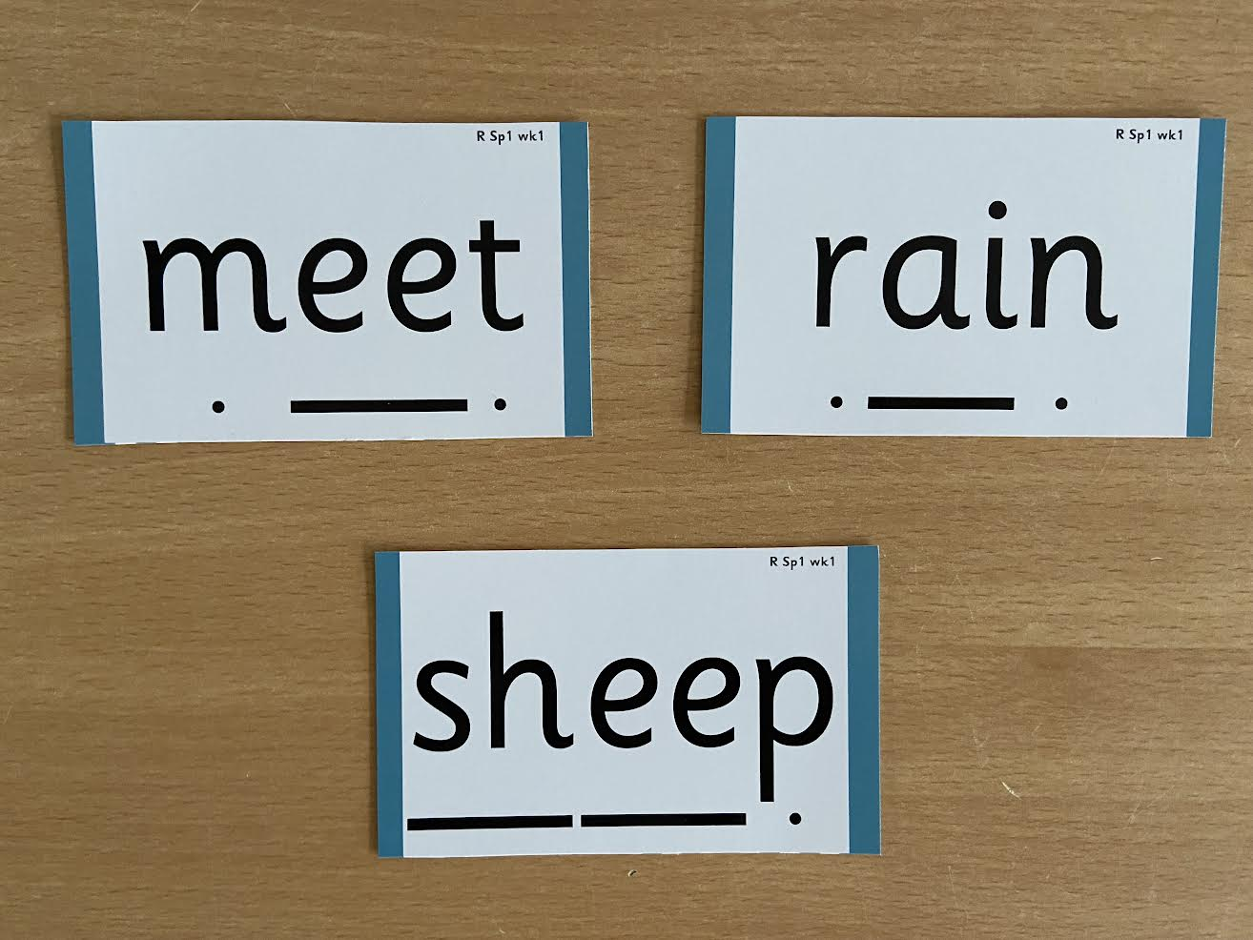
Notes:
Digraphs have a zip to sound talk and blend

Slide 13
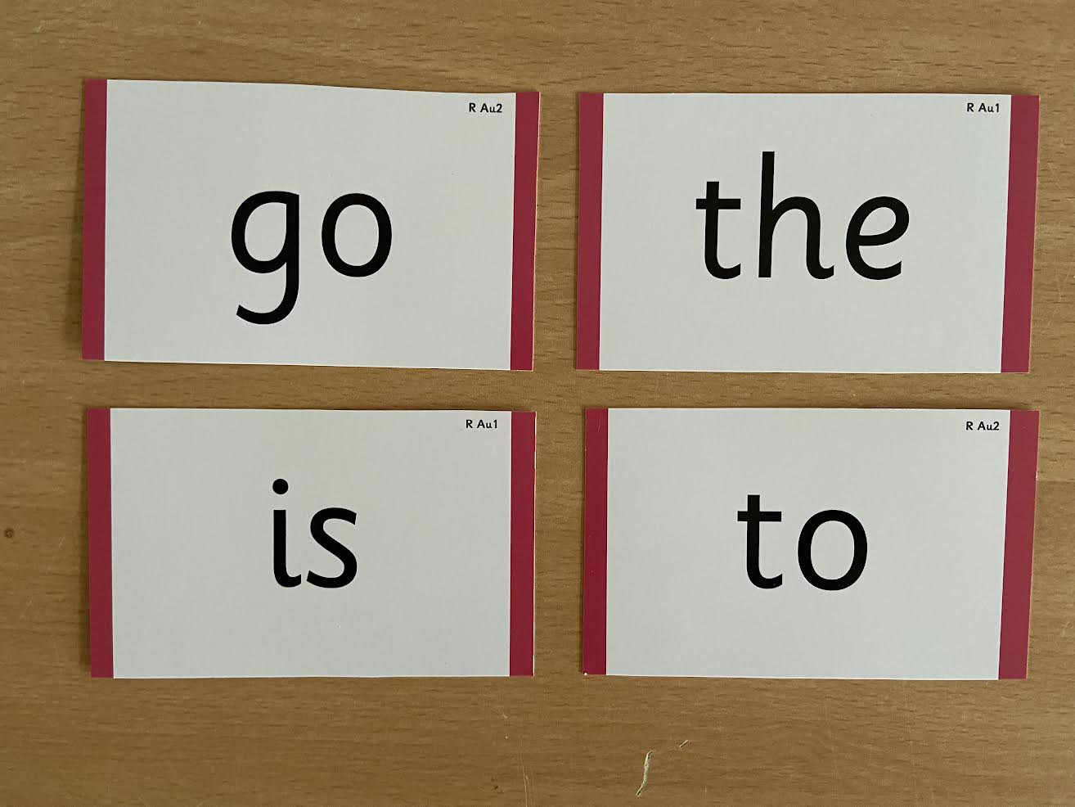
Notes:
Words that do not follow the rules and cannot be decoded – tricky words/ exception words
Chn are taught what part of the word is tricky

Slide 14
Jargon :-
You may hear your children say….
-Phonics (also known as ‘synthetic phonics’) – The teaching of reading by developing awareness of the sounds in words and the corresponding letters used to represent those sounds.
Phoneme (sound) - Any one of the 44 sounds which make up words in the English language.
-Grapheme – How a phoneme is written down. There can be more than one way to spell a phoneme. E.g-the phoneme ‘ay’ is spelt differently in each of the words ‘way’, ‘make’, ‘fail’, ‘great’, ‘sleigh’ and ‘lady’.

Slide 15
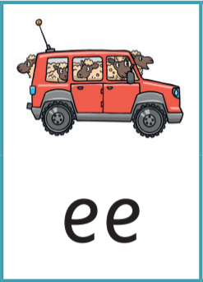
Jargon contd
-Blending – Putting together the sounds in a word in order to read it, e.g.
‘f – r – o – g, frog’
-Segmenting – Breaking a word into sounds in order to spell
them, e.g. ‘frog, f – r – o – g’’
-Digraph- 2 letters making one sound
-Trigraph- 3 letters making one sound

Slide 16
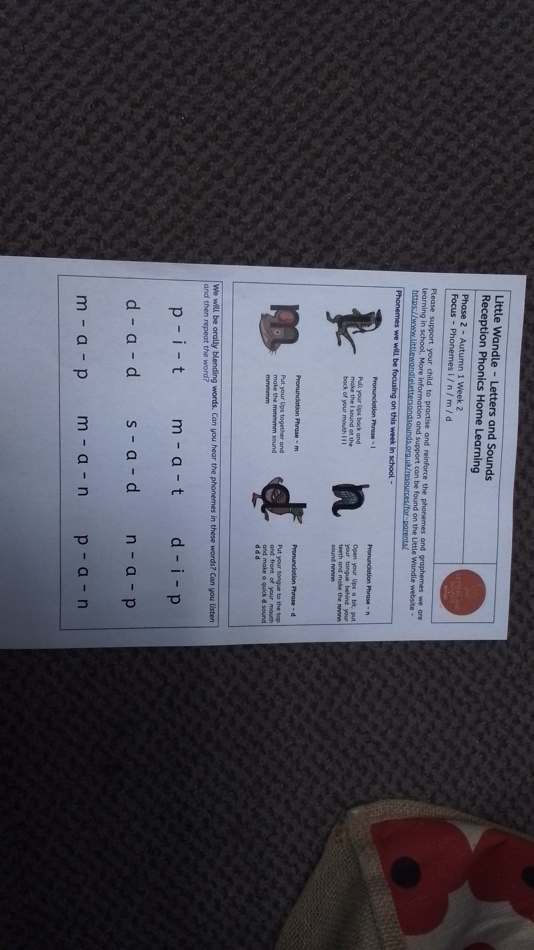

Slide 17
Reading
We want children to
love reading
Learning to read should be
a positive experience
We want children to read
for pleasure and be life
long readers
Reading should be
enjoyable
Reading underpins children’s access to the curriculum
and clearly impacts on their achievement
Notes:
We all know how important learning to read is and the impact it has on a childs success - it has to be a positive experience
Whats the reality? Reluctant to read because they find it hard
Frustration stress tears – that’s just the parents
Important to look at the big long term picture

Slide 18
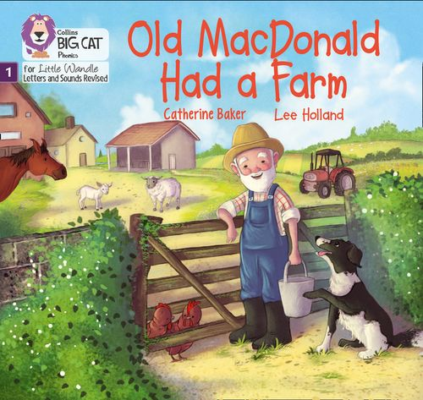
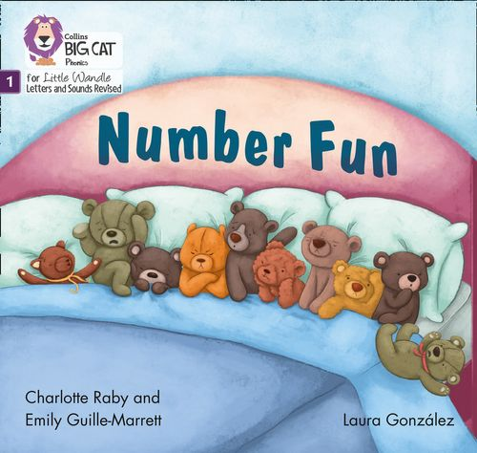
Once children have a secure knowledge of a number of
GPC’s (Grapheme Phoneme Correspondences)
and are confidently blending, they will be ready for
reading books.
Prior to this they may have wordless books which develop
great language skills and teach children the layout of books
and how to handle books

Slide 19
How we teach reading
Through the daily phonics session which is then put into context and reinforced through reading practice sessions.
Books are :
Timetabled 3 times a week
matched to children’s
secure phonic knowledge
and word reading and sent home.
Taught by trained teacher or
teaching assistant
Taught in small groups
Notes:
Quite a big difference to how reading was previously taught

Slide 20
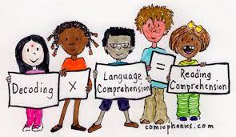
Reading Practice Books are carefully matched so children can read
fluently and independently
The sessions each week will follow an order starting with :-
Decoding
Prosody
(intonation, expression)
3. Comprehension
When children take their book home to read they should be 95% fluent.
Please do not worry that a book is too easy – your child needs to develop
fluency and confidence in reading. Re-reading a book they have had before
helps develop fluency – this is the goal.
Celebrate their success!!!

Slide 21
Reception and year 1
There are three types of books that your child will bring home:
A practice reading book. This will be at the correct phonic stage for your child. They should be able to read this fluently and independently, the aim is that by the end of the week they are sight reading the book. This book has been carefully matched to your child’s current reading level. If your child is reading it with little help, please don’t worry that it’s too easy – your child needs to develop fluency and confidence in reading. They will take this book home at the beginning of the week, it will need to be in school everyday as they will be using it during their daily group practice reading sessions. Listen to them read the book. This will be written in your child’s reading record on a Monday with the title and practice reading book alongside.

Slide 22
A home reading book. This book will be matched to your child’s current reading level based on the phonics they have been taught however there may be phonemes or words they have not been taught so they may need some support. Your child will choose this book from the phonetically decodable book banded boxes. We ask that your child reads this at least three times before we change the book to develop confidence and fluency. Listen to them read the book – remember to give them lots of praise – celebrate their success! After they have finished reading the book, talk about it and ask questions to help them understand the text. This will also be written in their reading records with the title and home reading book.

Slide 23
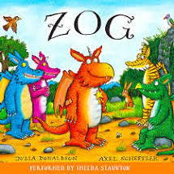
Supporting at home.
Reading for pleasure books
Children will also bring home a ‘reading for pleasure book’ from our class library each week.
To become lifelong readers, it is essential that they read for pleasure
Children may not be able to read this book independently but these books offer a wealth of opportunities for talking about the pictures and enjoying the story or information text.
Enjoy the book together and
foster a love of reading

Slide 24
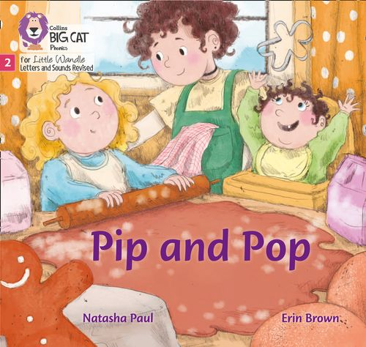
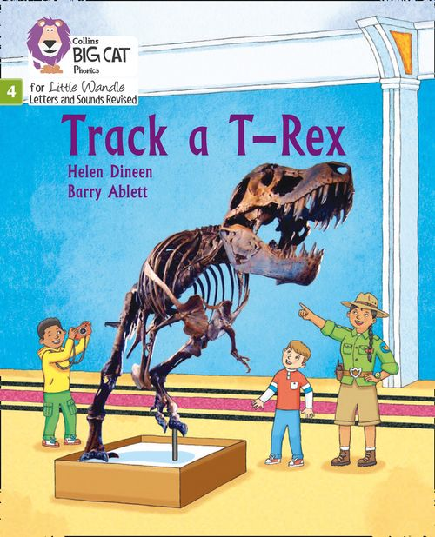
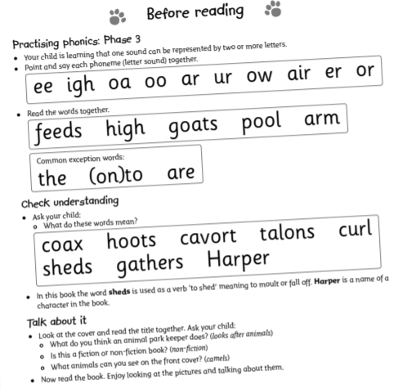
Reading with your child :-
Celebrate, praise, talk about the book with your child.
Please make sure books are in book bags every day
as they will need them for practice reading
Sessions in school.
Please look after our books.
Notes:
Children will not be changing book multiple times a week as previously
Reading groups will be set up so you will be notified of when your book will be sent home/ need to be back in school
Groups will change!

Slide 25
What else can parents do?
Please look at the Little Wandle videos and guidance for parents on the supporting your child section of our website.
Let your child “show off” their reading to you and celebrate and praise all the way!
Share books with your children for pleasure
Check on your class dojo page for documents to support reading and phonics

