Slide 2
Why we do it?
Research has proven that handwriting is a complex skill and that many children have difficulty because they have not developed the necessary physical skills and hand eye co-ordination to be able to learn to write
easily.
Making handwriting automatic
…so all the attention of the brain can be on the content.

Slide 3
Key Principles behind Kinetic Letters
Physical strength underpins handwriting, as poor handwriting may be the result of poor strength.
Children are not expected to do anything unless they are developmentally ready.
The different components of writing are mastered individually before being used in combination.
Letters are learnt as movements not as visual shapes and movement remains central to developing flow and fluency.
Handwriting is made easier using a pen and white board.
Lying on the floor to write enables the hand to be held in the correct position for writing.

Slide 4
The four strands of kinetic letters…..

Slide 5
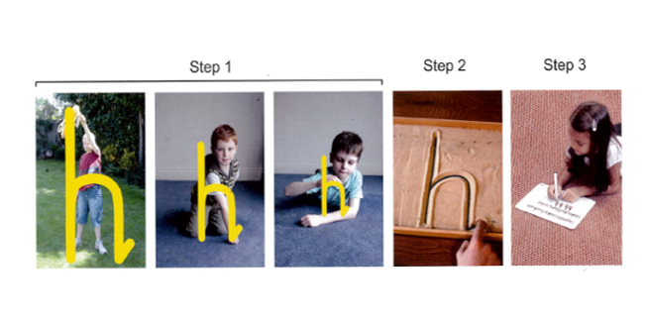
Red strand
In the first term of reception, the focus is building core strength and developing fine motor skills.
Children use a wand / writing in the air to learn the 6 movements of writing. They then move to writing in the sand and then to a whiteboard / paper.

Slide 7
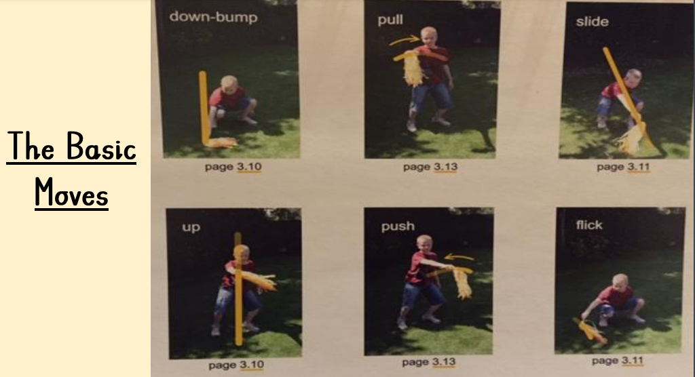

Slide 8
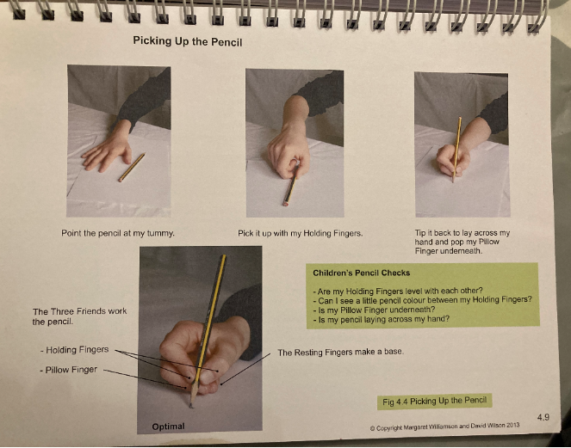
Green strand

Slide 9
Yellow strand
Six physical movements are learnt for writing letters
Large scale movements are integrated with small letters
Letters are learnt in groups according to their movements
Letters are taught in a progressive order
The writing tools for handwriting sessions are always pens and whiteboards

Slide 10
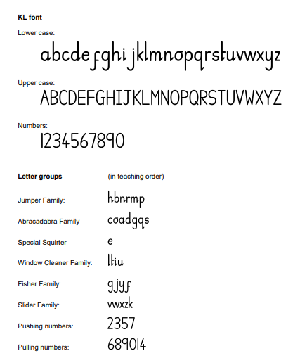

Slide 11
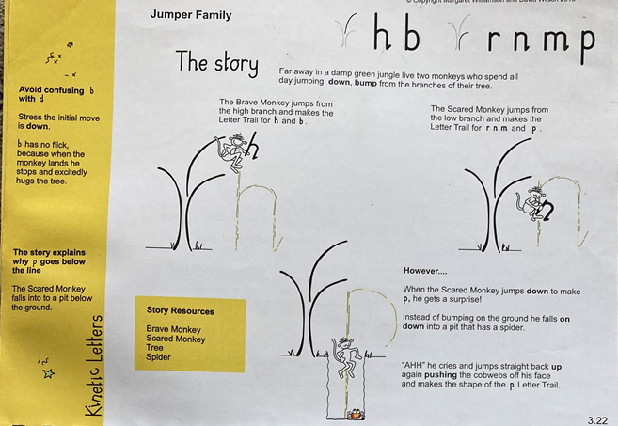

Slide 12
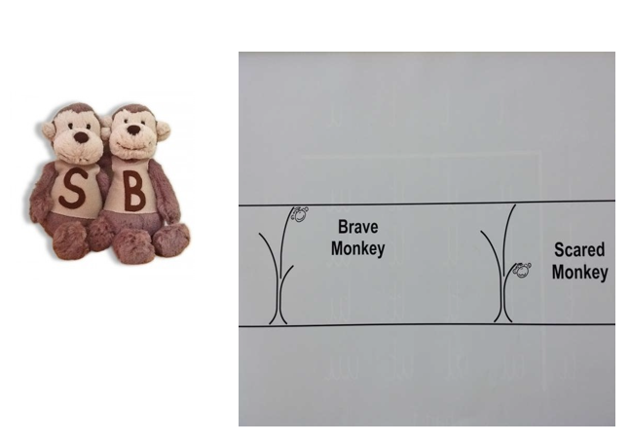
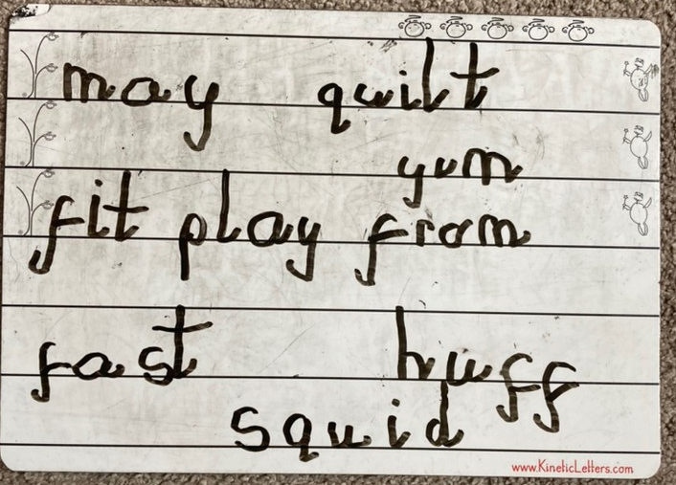

Slide 14
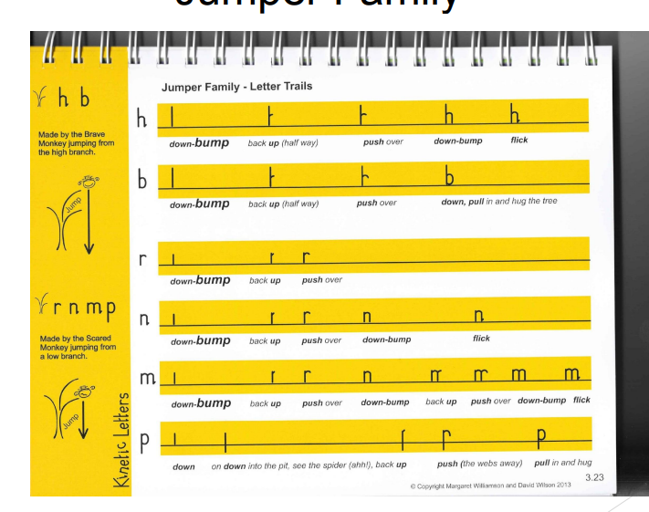

Slide 15
https://youtu.be/jq6y8wVhYGU
https://youtu.be/ojLYWKx8228

Slide 16
Blue strand

Slide 17
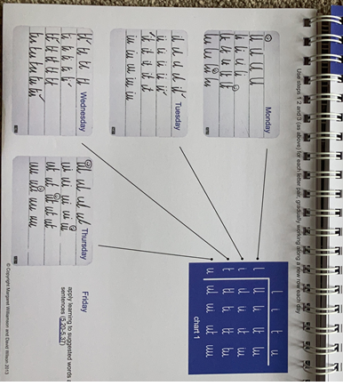

Slide 18
