Slide 1
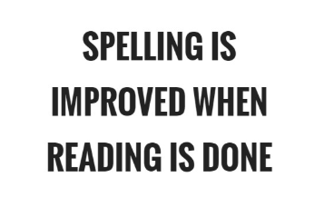
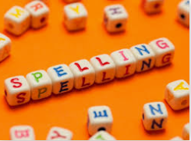
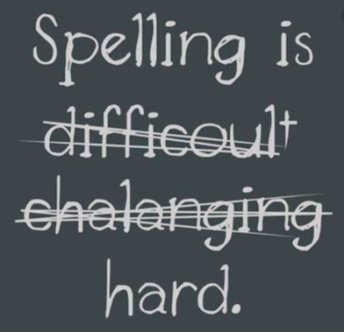
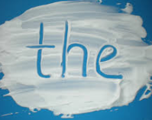
Spelling workshop
Clee Hill Community Academy

Slide 5
Pobble 365
http://www.pobble365.com/
This is a great website for encouraging children to write at home. There is a picture for every day of the year with suggested writing activities.

Slide 6
Pobble 365

Slide 7
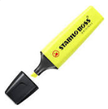
Correcting spellings
In school, we use yellow highlighters to underline an incorrect spelling – ‘yellow spello’.
You could use this at home to highlight any incorrect words in your child’s writing.

Slide 8
Have a go spelling books
In school, we use ‘have a go’ spelling books.
These are small books with one page for each letter of the alphabet with a line down the middle.
Your child attempts the spelling on the first side, using their spelling strategies. Teacher / parent ticks if it is correct or writes the correct spelling, talking about where the child went wrong.

Slide 10
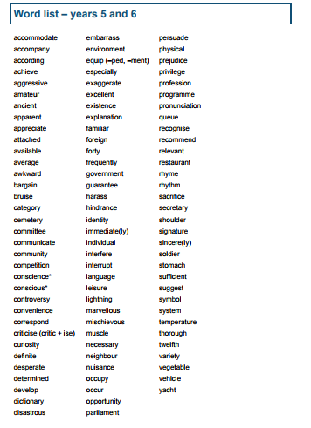

Slide 11
SPICE
S – support
P – patient
I – interest
C- challenge
E – Encouragement

Slide 12
Strategies to help with learning spellings

Slide 13
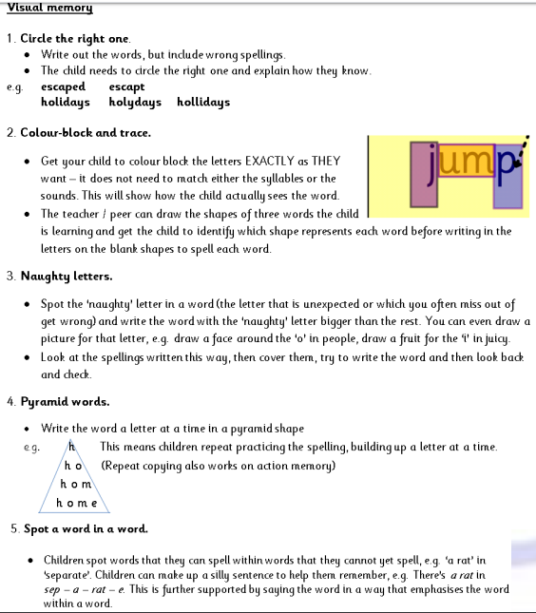

Slide 14
Auditory memory

Slide 15
Kinaesthetic memory

Slide 16
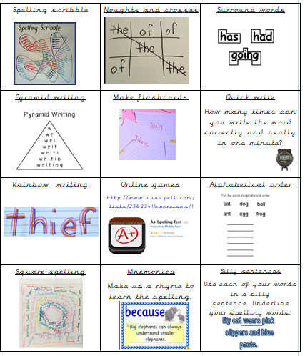
Examples of spelling strategies

Slide 17
Rainbow writing

Slide 18
Surround words

Slide 19
Spelling scribble

Slide 21
Noughts and crosses

Slide 22
Square spelling

